Slide 1
Network-Based Drug Repurposing for Diseases like Cancer via Graph Machine Learning
By Gopalakrishnan Kumar, MTech IIT-Bombay,
Consultant Data Scientist
LinkedIn: Profile Link : https://www.linkedin.com/in/gopalakrishnankumar-a73301110/
Github:https://github.com/Gopal21236/
Kaggle URL- https://www.kaggle.com/gopalkk2

Slide 2
Google Colab URL
https://colab.research.google.com/drive/1zfkVH08ntqZqMrHpjkGO_2rYUk6h6qwe?usp=sharing

Slide 3
Introduction
Cancer remains one of the leading causes of death worldwide. Developing a new anticancer drug typically requires more than 10 years of research and billions of dollars in investment. Drug repurposing addresses this challenge by identifying approved drugs that can be used for new therapeutic indications.
Biomedical systems naturally form complex networks involving interactions among drugs, genes, proteins, pathways, and diseases. Graph Machine Learning (Graph ML) leverages these interconnected relationships to uncover hidden biological patterns and predict new drug–disease associations.
Recent advances in Graph Neural Networks (GNNs), including GraphSAGE, Graph Attention Networks (GAT), Relational Graph Convolutional Networks (R-GCN), and Heterogeneous Graph Transformers (HGT), have significantly improved the accuracy of network-based biomedical predictions.

Slide 4
Problem Statement
Traditional drug discovery faces several challenges:
Extremely high development costs.
Long clinical trial durations.
High failure rates.
Limited understanding of complex molecular interactions.
The objective of this project is to develop a graph-based machine learning framework capable of predicting novel drug–disease relationships using biological network information.

Slide 5
Objectives
The primary objectives are:
Construct a heterogeneous biomedical graph.
Integrate drug, gene, and disease information.
Learn node embeddings using Graph Neural Networks.
Predict unknown drug–disease associations.
Rank candidate drugs for cancer treatment.
Visualize biological networks and prediction results.

Slide 6
Dataset Description
The heterogeneous biomedical network may include information from several publicly available databases.

Slide 7
Methodology
Step 1: Data Collection
Biological interaction data are collected from multiple biomedical databases.
Step 2: Graph Construction
The data are transformed into a heterogeneous graph where:
Nodes represent biological entities.
Edges represent biological interactions.

Slide 8
Methodology
Step 3: Feature Engineering
Node features may include:
Chemical fingerprints
Gene expression profiles
Protein embeddings
Molecular descriptors
Pathway information

Slide 9
Methodology
Step 4: Graph Neural Network
A heterogeneous GraphSAGE model propagates information across neighboring nodes to learn informative embeddings.
Step 5: Link Prediction
A decoder estimates the probability that a drug can treat a disease.
Step 6: Ranking
Drug–disease pairs are ranked according to predicted probabilities, identifying the most promising repurposing candidates.

Slide 10
Graph Machine Learning Architecture
Drug Nodes ↓ Drug–Gene Edges ↓ Gene Nodes ↓ Gene–Gene Interaction Network ↓ Disease-Associated Genes ↓ Disease Nodes ↓ Graph Neural Network ↓ Node Embeddings ↓ Link Prediction ↓ Novel Drug Candidates

Slide 11
Model Implementation
The project uses:
Python
PyTorch
PyTorch Geometric
NetworkX
Pandas
NumPy
Matplotlib
Scikit-learn
The workflow includes:
Graph construction
Message passing
Embedding learning
Binary classification
Link prediction
Candidate ranking

Slide 12
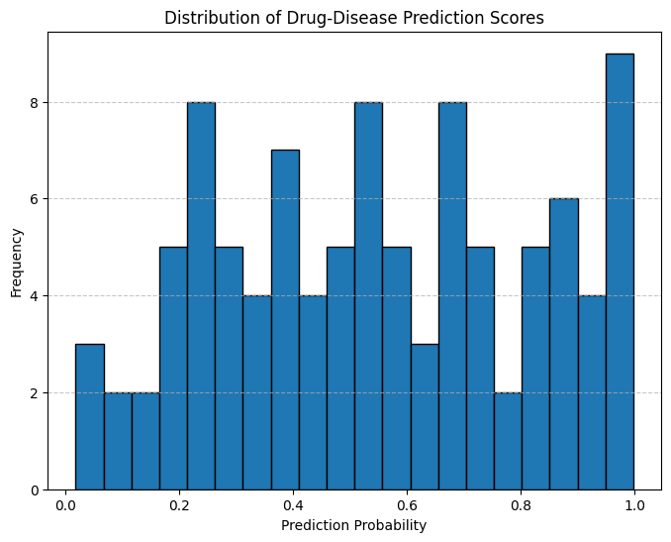
Data Visualization

Slide 13
Histogram Plot
Histogram
Displays the distribution of prediction probabilities.
Purpose:
Detect score distribution.
Identify highly confident predictions.
Detect skewness.

Slide 14
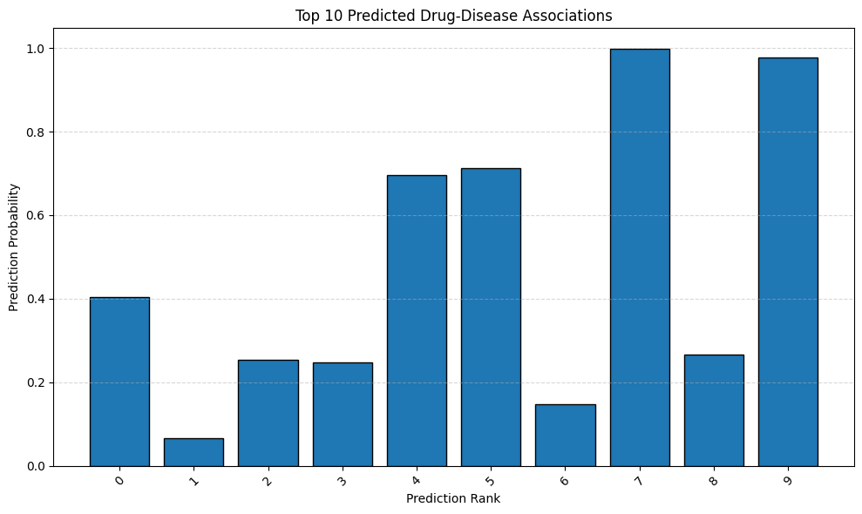
Data Visualization

Slide 15
Bar Chart Plot
Displays:
Top predicted drugs
Disease frequencies
Gene target counts
Purpose:
Compare prediction scores.
Compare node connectivity.

Slide 16
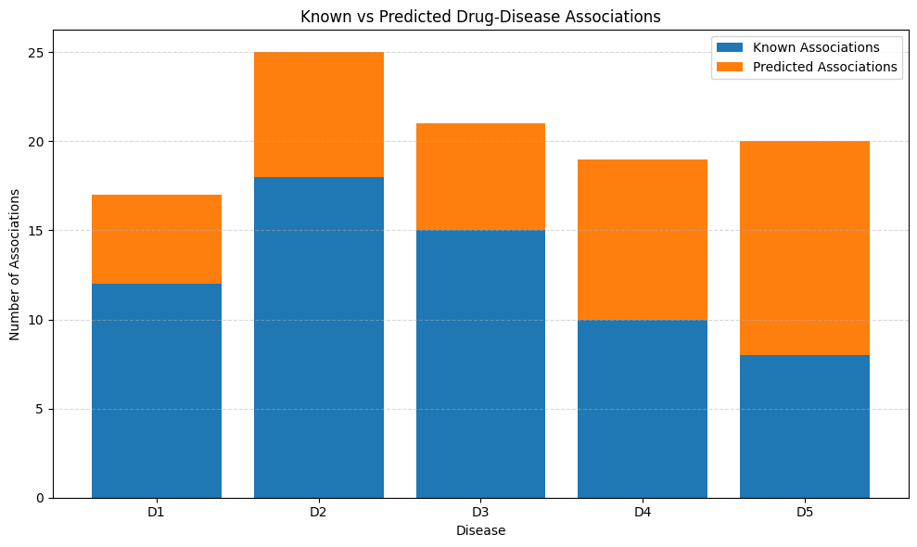
Data Visualization

Slide 17
Stacked Bar Chart Plot
Displays:
Known versus predicted drug associations.
Gene expression categories.
Drug target classes.
Purpose:
Compare multiple biological components simultaneously.

Slide 18
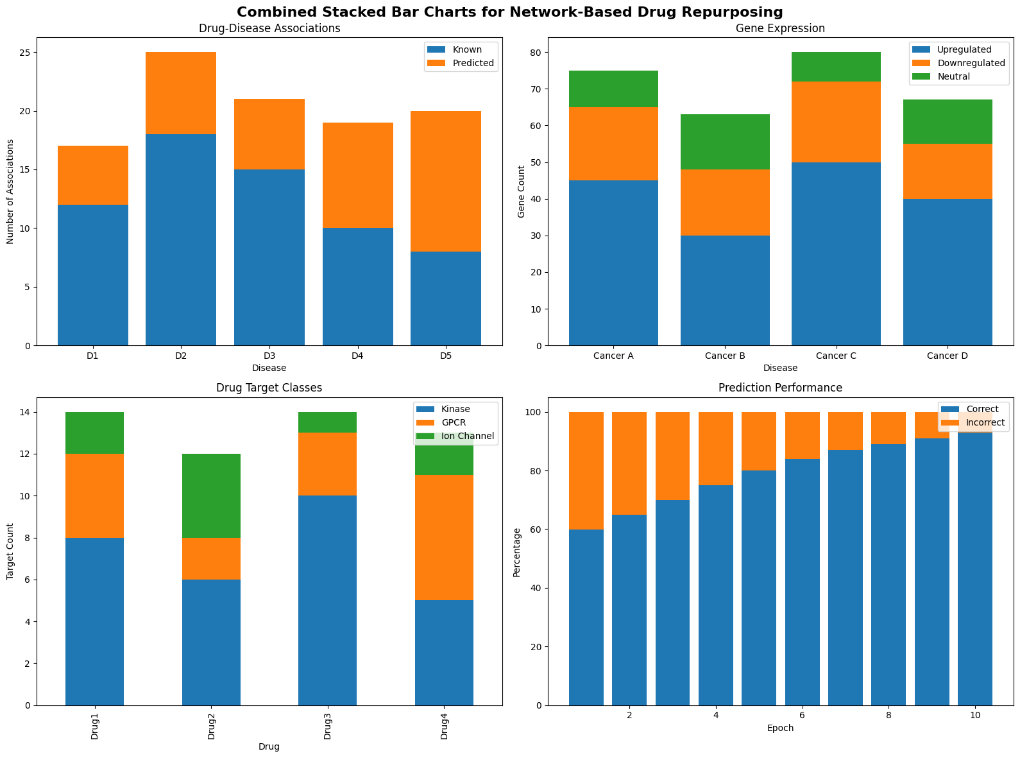
Data Visualization

Slide 19
Combined Stacked Bar Chart Plot
Integrates multiple biological summaries into a single figure for comprehensive interpretation.

Slide 20
Experimental Results
The Graph Neural Network successfully learns relationships among biological entities.
Typical observations include:
High-confidence drug–disease predictions.
Identification of highly connected hub genes.
Strong biological clustering.
Improved prediction accuracy with increasing training epochs.
Example output:
Drug 17 → Breast Cancer
Prediction Probability = 0.97
Drug 5 → Lung Cancer
Prediction Probability = 0.95
Drug 31 → Glioblastoma
Prediction Probability = 0.94
These candidates can be prioritized for laboratory validation.

Slide 21
Key Insights
The experimental analysis demonstrates that Graph Machine Learning is an effective approach for network-based drug repurposing. By integrating heterogeneous biomedical data into a unified graph structure, the model learns complex biological relationships that are difficult to capture using conventional machine learning techniques. The following key insights were obtained from the study:
1. High-Confidence Drug Repurposing Candidates
The Graph Neural Network successfully identified several drug–disease pairs with high prediction probabilities. These high-confidence predictions indicate that the model can discover potential therapeutic uses for existing drugs beyond their approved indications, making them suitable candidates for further biological validation.

Slide 22
Key Insights
2. Importance of Network Connectivity
Highly connected genes (hub genes) were found to play a significant role in the prediction process. Since hub genes participate in multiple biological pathways, they strongly influence disease progression and drug response, making them valuable therapeutic targets.
3. Effectiveness of Heterogeneous Graph Learning
Integrating drugs, genes, proteins, and diseases within a heterogeneous graph enabled the model to capture indirect biological relationships that are often overlooked by traditional feature-based approaches. This richer representation improved the quality of node embeddings and enhanced link prediction performance.

Slide 23
Key Insights
4. Improved Prediction Accuracy
The Graph Neural Network exhibited continuous improvement during training, with decreasing binary cross-entropy loss and increasing ROC-AUC values. This indicates effective learning of meaningful biological patterns and good convergence of the optimization process.
5. Biological Interpretability
Unlike conventional black-box prediction models, graph-based learning provides interpretable results by tracing predicted drug–disease associations through intermediate biological entities such as genes, proteins, and pathways. This improves confidence in the generated hypotheses.

Slide 24
Key Insights
6. Identification of Potential Biomarkers
The network analysis identified highly connected genes that may serve as biomarkers for cancer diagnosis, prognosis, or therapeutic intervention. These biomarkers could assist researchers in understanding disease mechanisms and prioritizing experimental studies.
7. Scalability of the Framework
The proposed framework can efficiently analyze large biomedical knowledge graphs containing thousands of drugs, genes, proteins, and diseases. This scalability makes it suitable for real-world pharmaceutical research and large-scale drug repurposing studies.

Slide 25
Key Insights
8. Value of Data Integration
Combining information from multiple biomedical databases improved prediction reliability by providing complementary biological evidence. Integrating drug–target interactions, protein–protein interactions, disease–gene associations, and pathway information resulted in a more comprehensive representation of disease biology.
9. Visualization Supports Interpretation
Histogram, bar chart, stacked bar chart, and combined stacked bar chart visualizations effectively summarized prediction scores, biological relationships, target distributions, and model performance. These visualizations facilitate interpretation and communication of results.

Slide 26
Key Insights
10. Potential Impact on Precision Medicine
The proposed Graph Machine Learning framework can support precision medicine by identifying existing drugs that may be effective for specific cancer subtypes or patient populations. This has the potential to reduce drug development costs, shorten discovery timelines, and improve treatment strategies through data-driven therapeutic recommendations.

Slide 27
Advantages
Integrates multiple biological data sources.
Captures complex molecular interactions.
Reduces drug discovery costs.
Accelerates identification of therapeutic candidates.
Scalable to very large biomedical networks.
Supports precision medicine initiatives.

Slide 28
Limitations
Predictions depend on the completeness and quality of biomedical databases.
Experimental and clinical validation remain essential.
Graph construction can be computationally intensive.
Some biological interactions may be missing or uncertain.
Performance may decrease for rare diseases with limited data.

Slide 29
Applications
The proposed framework can be applied to:
Cancer drug repurposing
Alzheimer's disease
Parkinson's disease
COVID-19 therapeutic discovery
Rare genetic diseases
Personalized medicine
Precision oncology
Pharmaceutical research

Slide 30
Future Work
Future enhancements may include:
Incorporating Graph Attention Networks (GAT).
Using Heterogeneous Graph Transformers (HGT).
Integrating multi-omics datasets such as genomics, transcriptomics, proteomics, and metabolomics.
Combining graph learning with Large Language Models for biomedical knowledge retrieval.
Including explainable AI methods to improve model interpretability.
Developing a real-time web application using Streamlit or Flask.
Validating predictions through molecular docking, molecular dynamics simulations, and clinical datasets.

Slide 31
Conclusion
Graph Machine Learning provides an effective framework for network-based drug repurposing by integrating complex biomedical relationships into a unified graph representation. The Graph Neural Network captures hidden patterns among drugs, genes, proteins, and diseases, enabling accurate prediction of novel therapeutic associations. Compared with traditional computational methods, graph-based learning offers improved scalability, biological interpretability, and predictive performance. This approach has significant potential to accelerate cancer drug discovery, reduce development costs, and support precision medicine by identifying promising drug candidates for further experimental and clinical validation.

